Slide 1
Reinforcement Learning
Chih-Fan Hsu

Slide 2
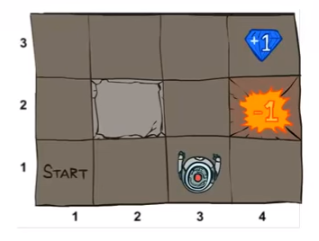
Maze Game
CS188 Artificial Intelligence
UC Berkeley, Spring 2014 Lecturer: Prof. Pieter Abbeel

Slide 3

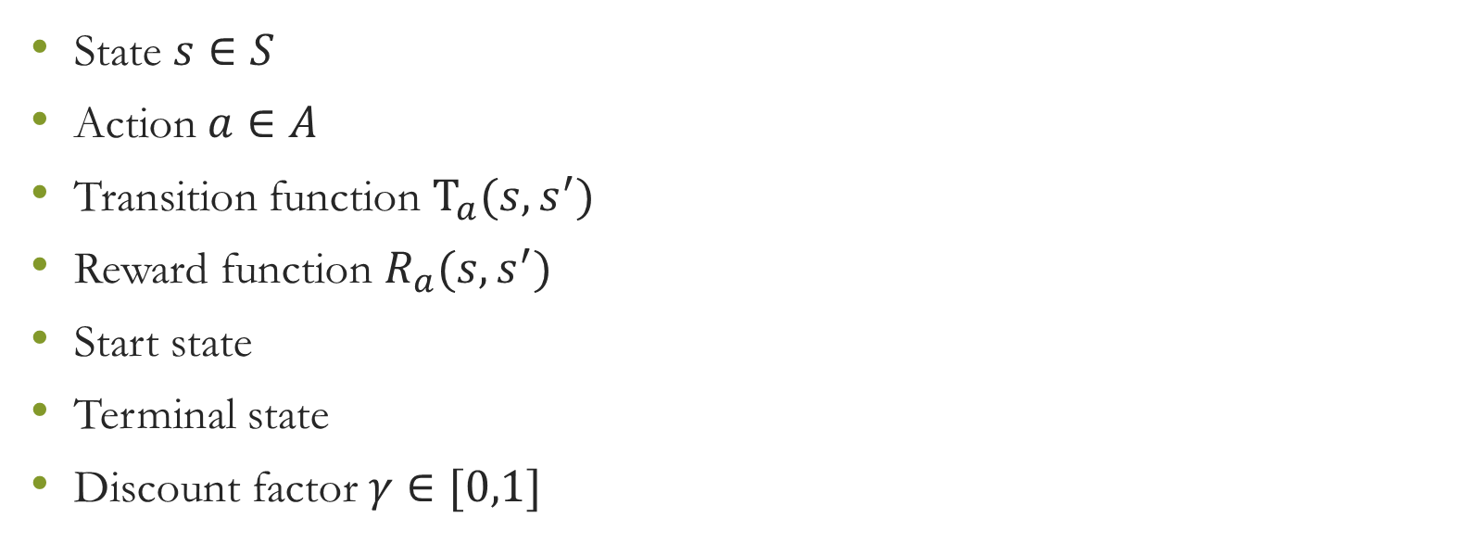
Markov Decision Processes (MDP)
State $s∈S$
Action $a∈A$
Transition function $T_{a}(s,s^{′})$
Reward function $R_{a}(s,s^{′})$
Start state
Terminal state
Discount factor$γ∈[0,1]$

Slide 4
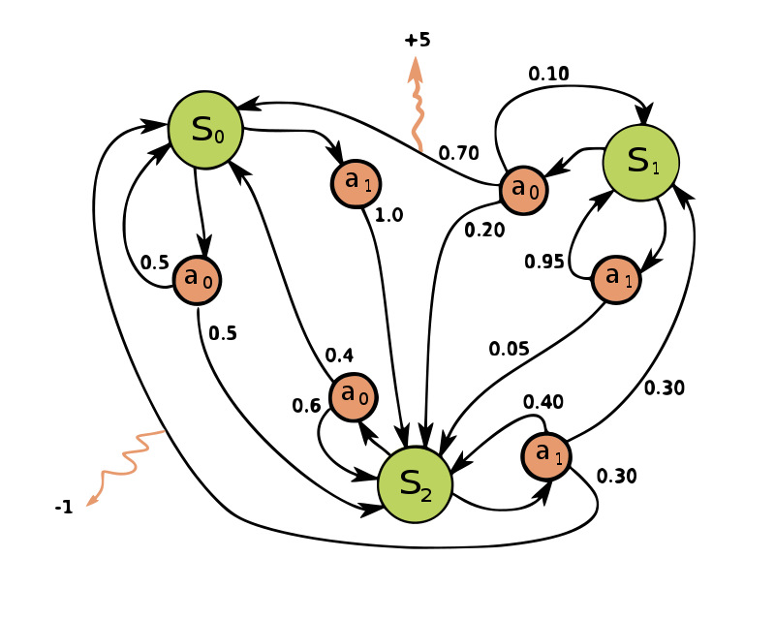
An Example

Slide 5
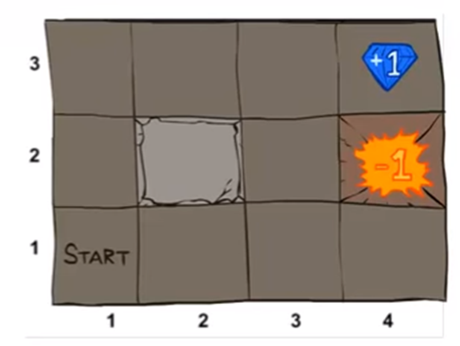
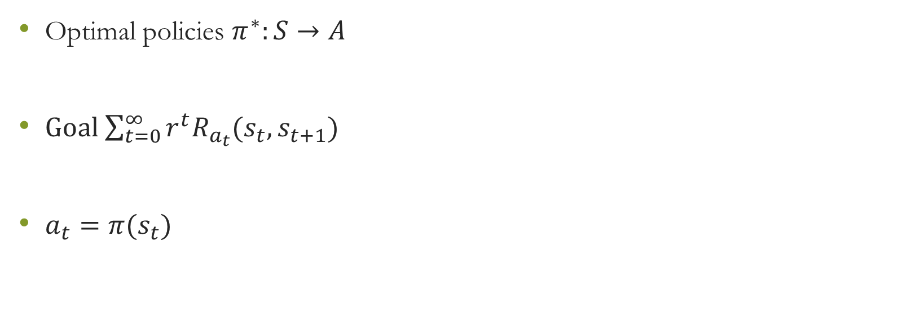
Goal – Find a Policies
Optimal policies $π^{∗}:S→A$
Goal $\sum_{t=0}^{∞}{r^{t}R_{a_{t}}(s_{t},s_{t+1})}$
$a_{t}=π(s_{t})$

Slide 6
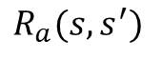
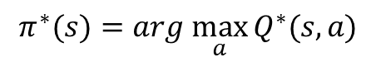
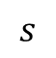
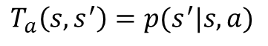
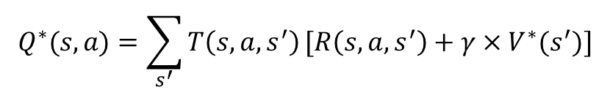
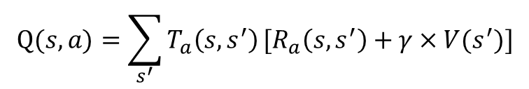
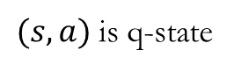
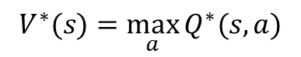
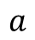
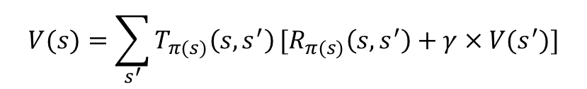
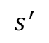
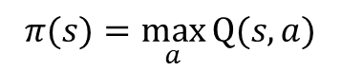
MDP - Search Tree
$$s$$
$$π(s)=\max_{a}{Q(s,a)}$$
$$a$$
$$Q(s,a)=\sum_{s^{′}}{T_{a}\left(s,s^{′}\right)}[R_{a}\left(s,s^{′}\right)+γ×V(s^{′})]$$
$$V(s)=\sum_{s^{′}}{T_{π(s)}\left(s,s^{′}\right)}[R_{π(s)}\left(s,s^{′}\right)+γ×V(s^{′})]$$
$(s,a)$ is q-state
$$T_{a}\left(s,s^{′}\right)=p(s^{′}|s,a)$$
$$V^{∗}(s)=\max_{a}{Q^{∗}(s,a)}$$
$$R_{a}(s,s^{′})$$
$$Q^{∗}(s,a)=\sum_{s^{′}}{T\left(s,a,s^{′}\right)}[R\left(s,a,s^{′}\right)+γ×V^{∗}(s^{′})]$$
$$s^{′}$$
$$π^{∗}(s)=arg \max_{a}{Q^{∗}(s,a)}$$

Slide 7
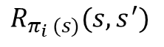
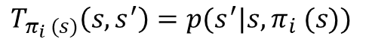
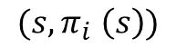
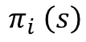
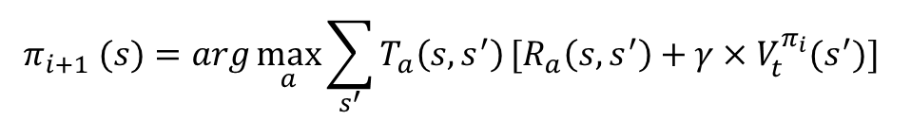
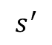
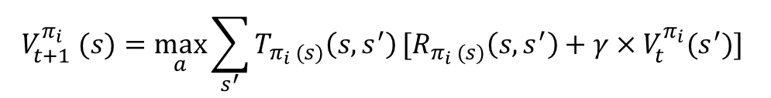
MDP – Iteration Update
$$s$$
$$V_{t+1}^{π_{i}} (s)=\max_{a}{\sum_{s^{′}}{T_{π_{i} (s)}\left(s, s^{′}\right)}[R_{π_{i} (s)}\left(s,s^{′}\right)+γ×V_{t}^{π_{i}}(s^{′})] }$$
$$π_{i} \left(s\right)$$
$$π_{i+1} (s)=arg\max_{a}{\sum_{s^{′}}{T_{a}\left(s,s^{′}\right)}[R_{a}\left(s,s^{′}\right)+γ×V_{t}^{π_{i}}(s^{′})] }$$
$$(s,π_{i} \left(s\right))$$
$$R_{π_{i} (s)}(s,s^{′})$$
$$T_{π_{i} (s)}\left(s,s^{′}\right)=p(s^{′}|s,π_{i} (s))$$
$$s^{′}$$

Slide 8
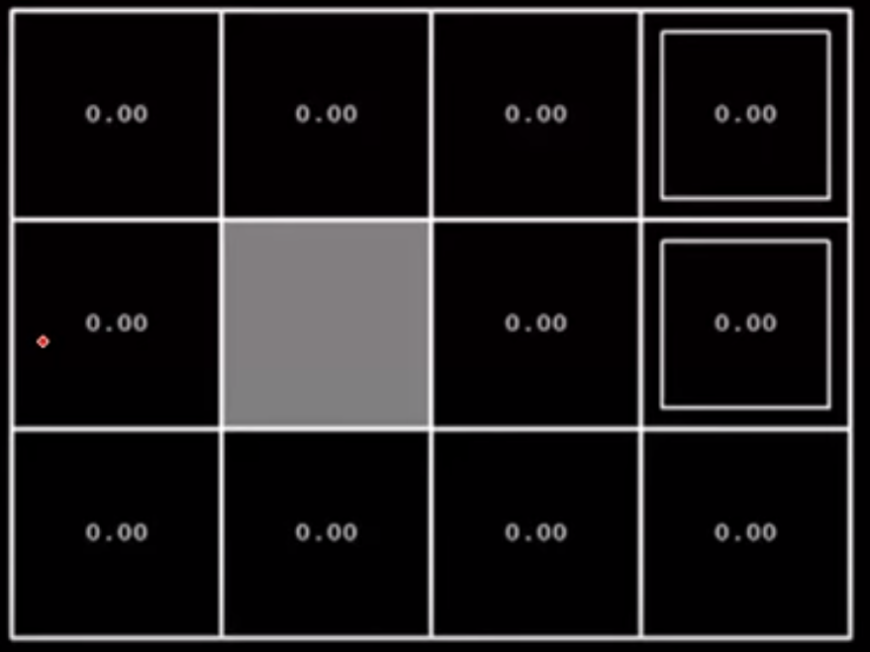
Training the Policies
Iteration 0

Slide 9
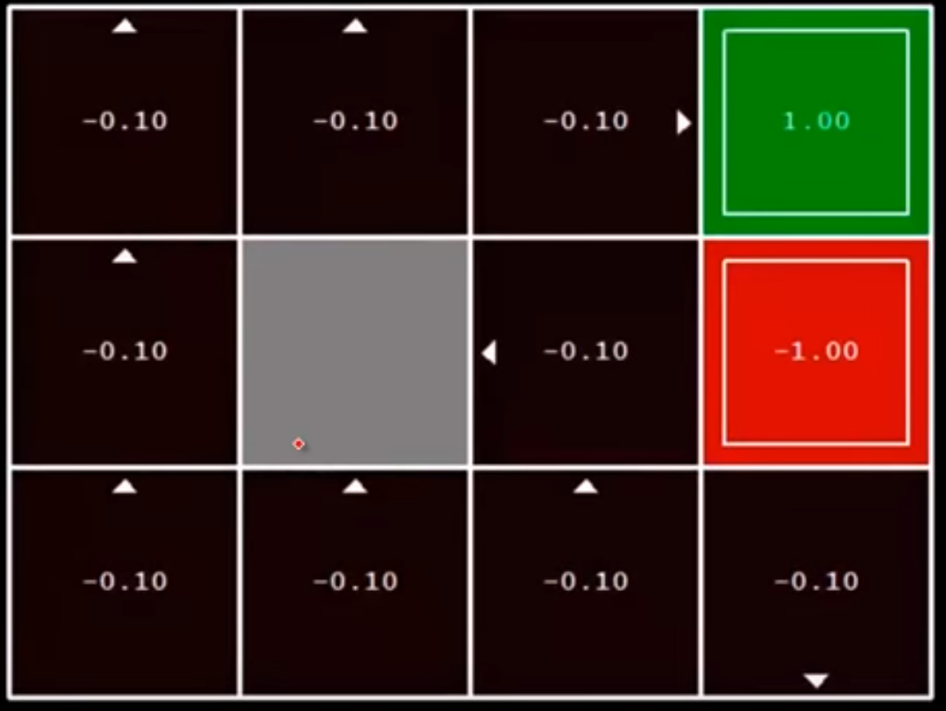
Training the Policies
Iteration 1

Slide 10
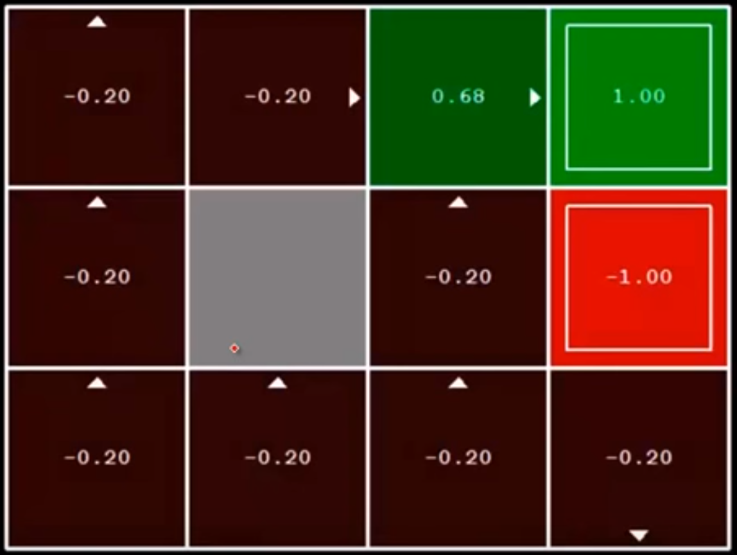
Training the Policies
Iteration 2

Slide 11
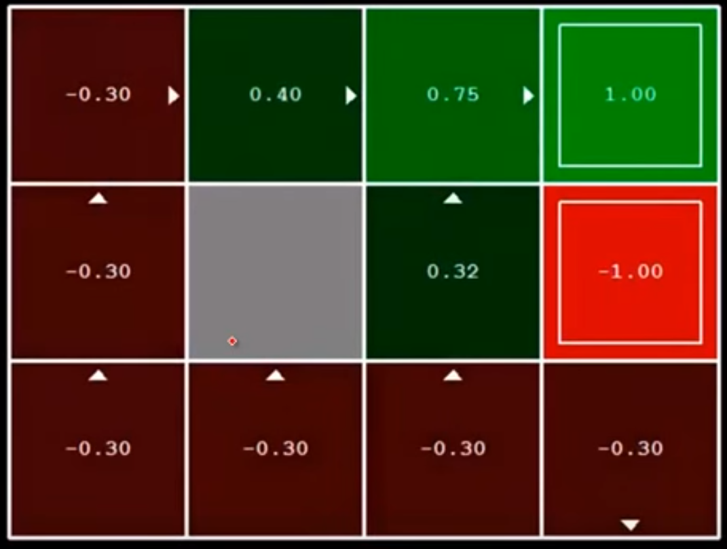
Training the Policies
Iteration 3

Slide 12
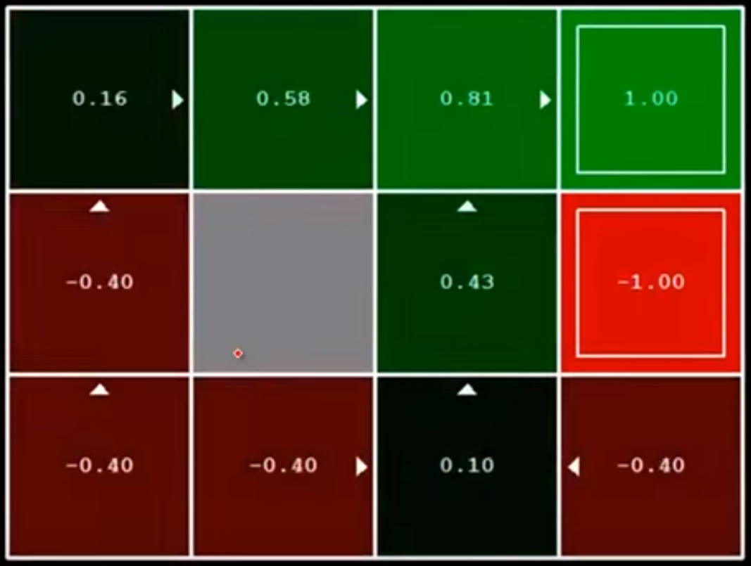
Training the Policies
Iteration 4

Slide 13
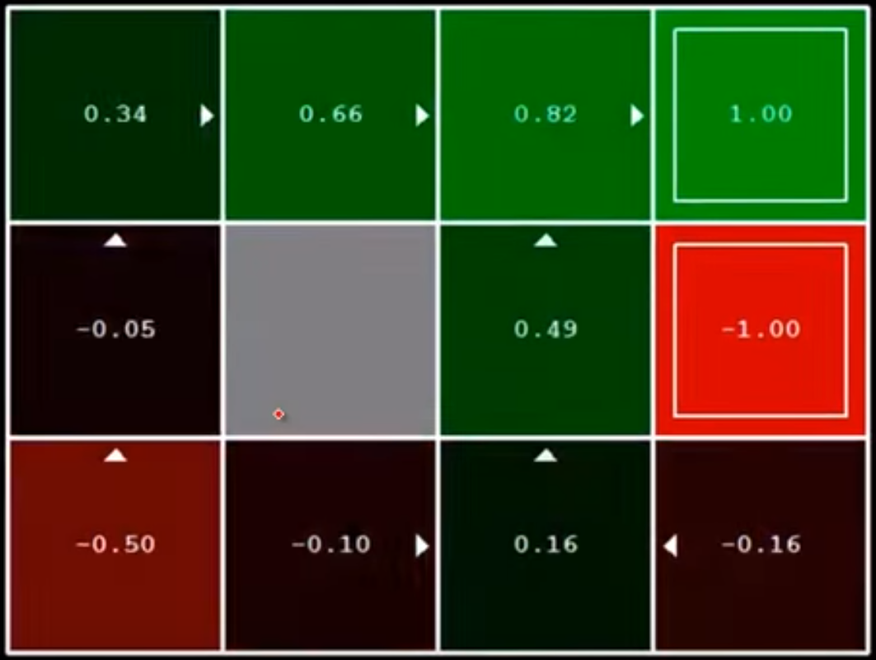
Training the Policies
Iteration 5

Slide 14
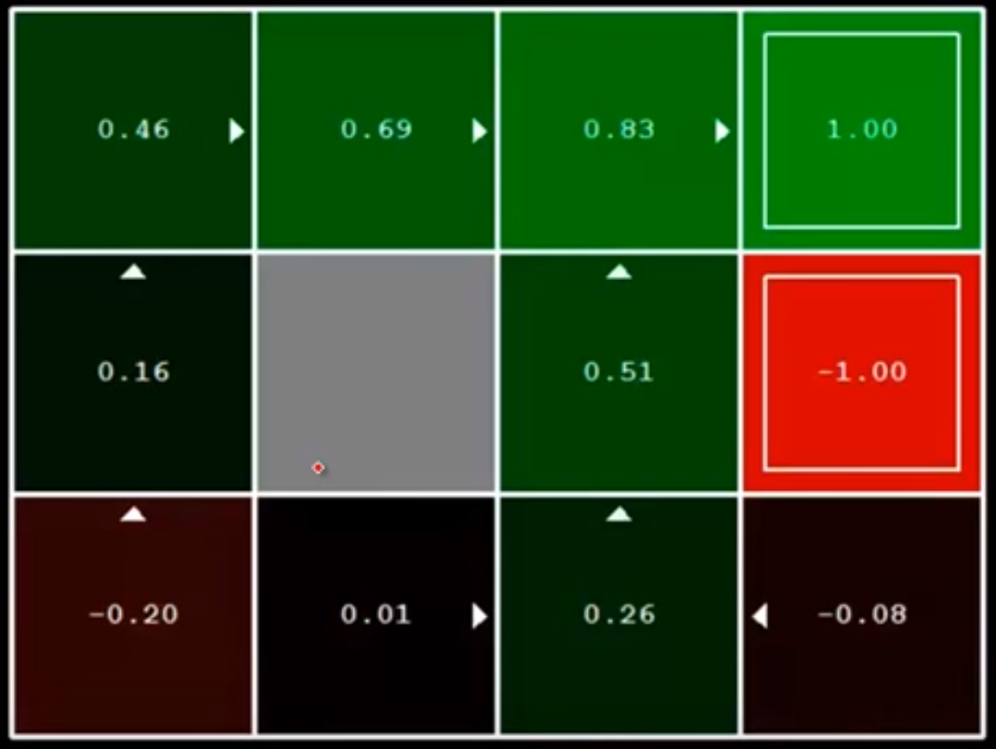
Training the Policies
Iteration 6

Slide 15
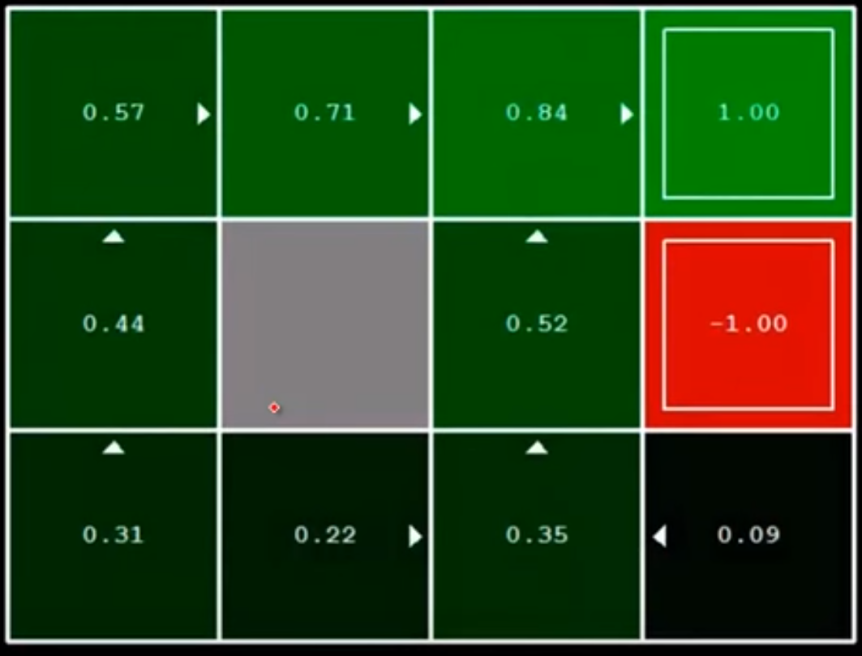
Training the Policies
Iteration 100

Slide 16
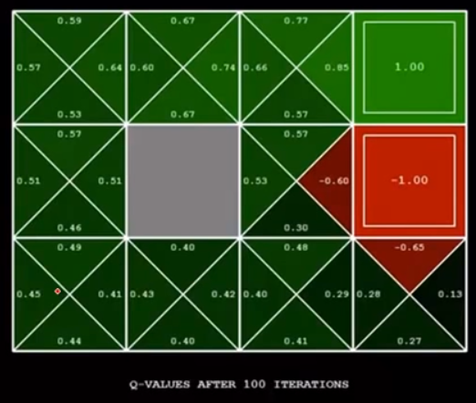
Final Q-Values

Slide 17
Reinforcement Learning (RL)
Some parameters we don’t know in MDP
Ideas
Exploration: try unknown action to obtain information
Exploitation: use what we know
Regret: make mistake
Sampling: try things repeatedly
Difficulty: much harder than MDP

Slide 18
RL – Active & Passive
Active Learning
Learning by observations
Passive Learning
Learning by trying

Slide 19
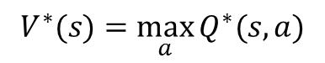
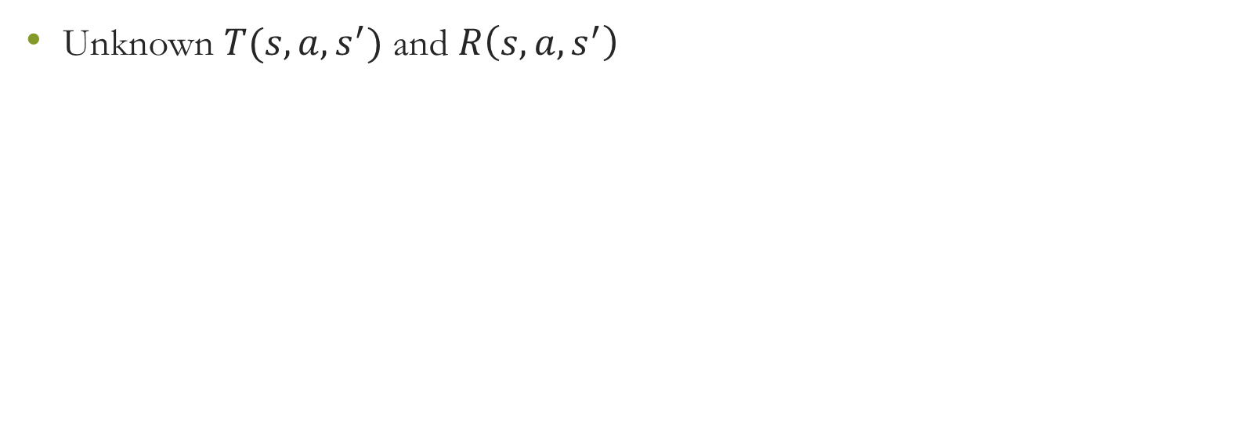
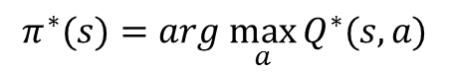
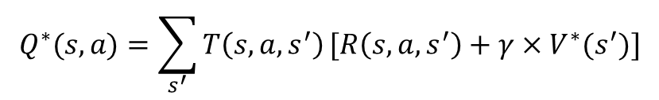
RL – Based on MDP
Unknown $T(s,a,s^{′})$ and $R\left(s,a,s^{′}\right)$
$$V^{∗}(s)=\max_{a}{Q^{∗}(s,a)}$$
$$Q^{∗}(s,a)=\sum_{s^{′}}{T\left(s,a,s^{′}\right)}[R\left(s,a,s^{′}\right)+γ×V^{∗}(s^{′})]$$
$$π^{∗}(s)=arg \max_{a}{Q^{∗}(s,a)}$$

Slide 20
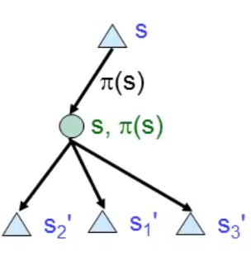
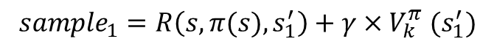
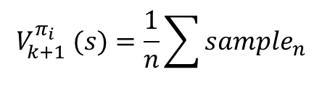
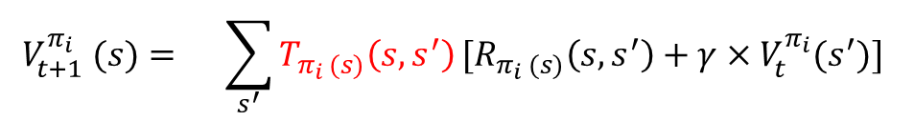
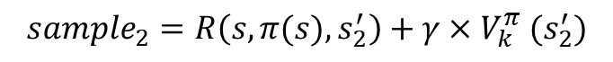
RL – Sampling
$$V_{t+1}^{π_{i}} (s)={\sum_{s^{′}}{T_{π_{i} (s)}\left(s, s^{′}\right)}[R_{π_{i} (s)}\left(s,s^{′}\right)+γ×V_{t}^{π_{i}}(s^{′})] }$$
$${sample}_{1}=R\left(s,π(s),s_{1}^{′}\right)+γ×V_{k}^{π} (s_{1}^{′})$$
$${sample}_{2}=R\left(s,π(s),s_{2}^{′}\right)+γ×V_{k}^{π} (s_{2}^{′})$$
$${sample}_{3}=R\left(s,π(s),s_{3}^{′}\right)+γ×V_{k}^{π} (s_{3}^{′})$$
$$V_{k+1}^{π_{i}} (s)=\frac{1}{n}\sum{{sample}_{n}}$$
Calculate V(s) Cost too much ;-<
S might not be visited again and again, since T is unknow ;-<

Slide 21
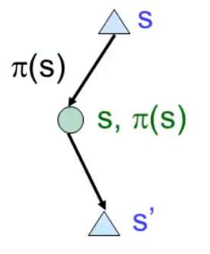
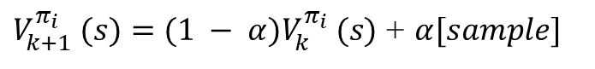
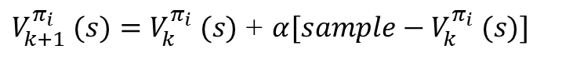
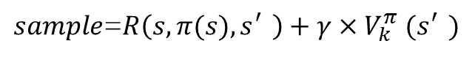
RL – Sampling
Learning from every experimence
$sample$=$R\left(s,π(s),s_{}^{′}\right)+γ×V_{k}^{π} (s_{}^{′})$
$V_{k+1}^{π_{i}} (s)=(1 − α)V_{k}^{π_{i}} (s)$ + $α[sample]$
$V_{k+1}^{π_{i}} (s)=V_{k}^{π_{i}} (s)$ + $α[sample−V_{k}^{π_{i}} (s)]$
$$Q_{k+1}^{π_{i}}(s,a)=(1 − α)Q_{k}^{π_{i}} (s,a)\text{ + }α[sample]$$

Slide 22
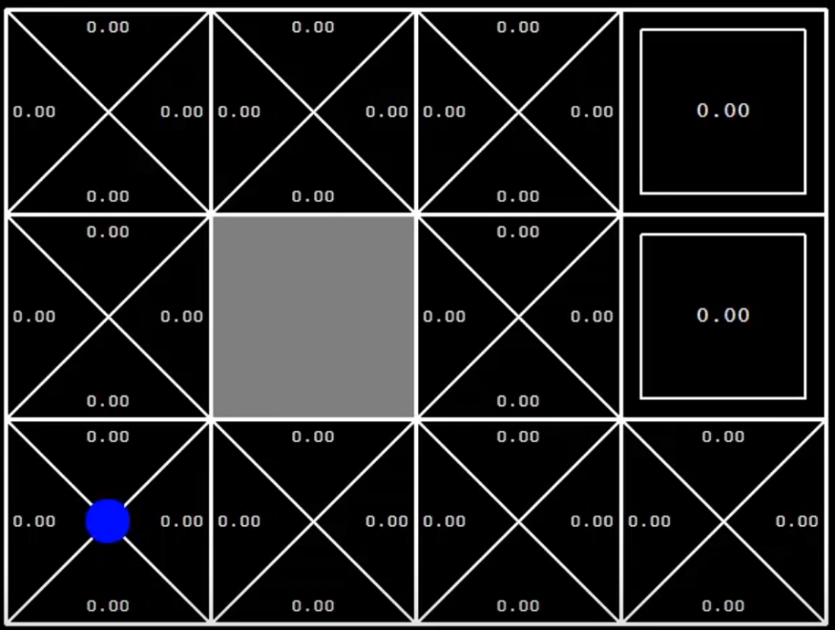
RL – Q-state Learning
Action 0

Slide 23
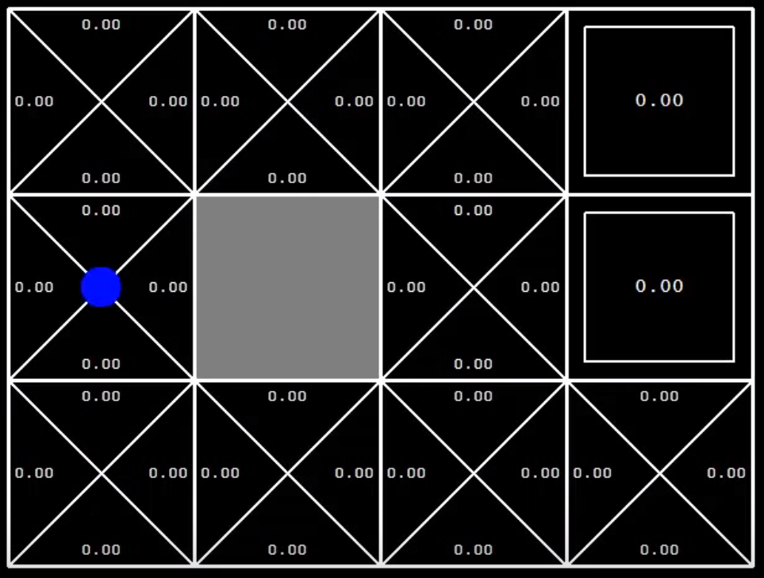
RL – Q-state Learning
Action 1

Slide 24
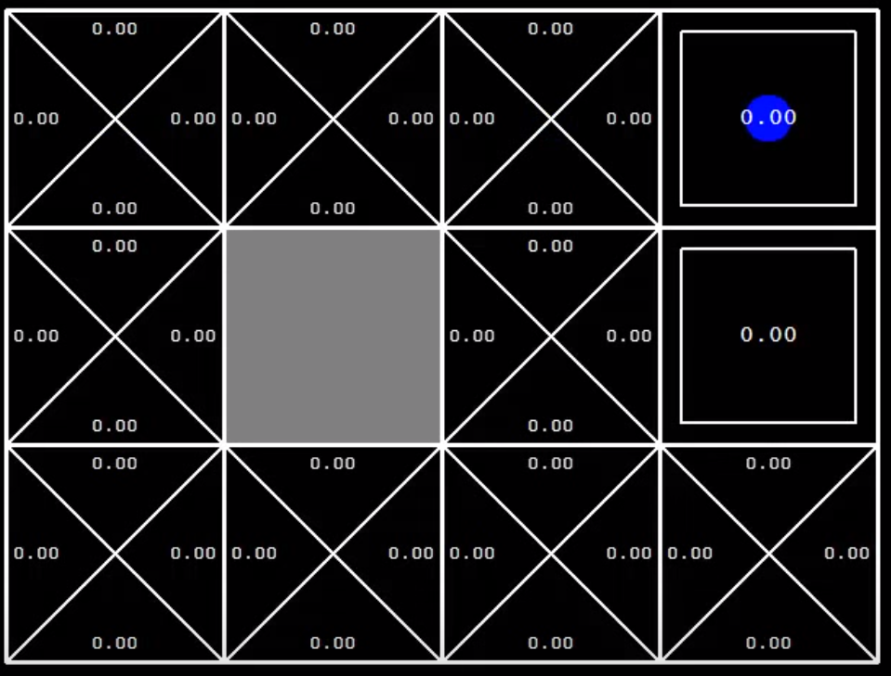
RL – Q-state Learning
Action 5

Slide 25
RL – Q-state Learning
Action 5

Slide 26
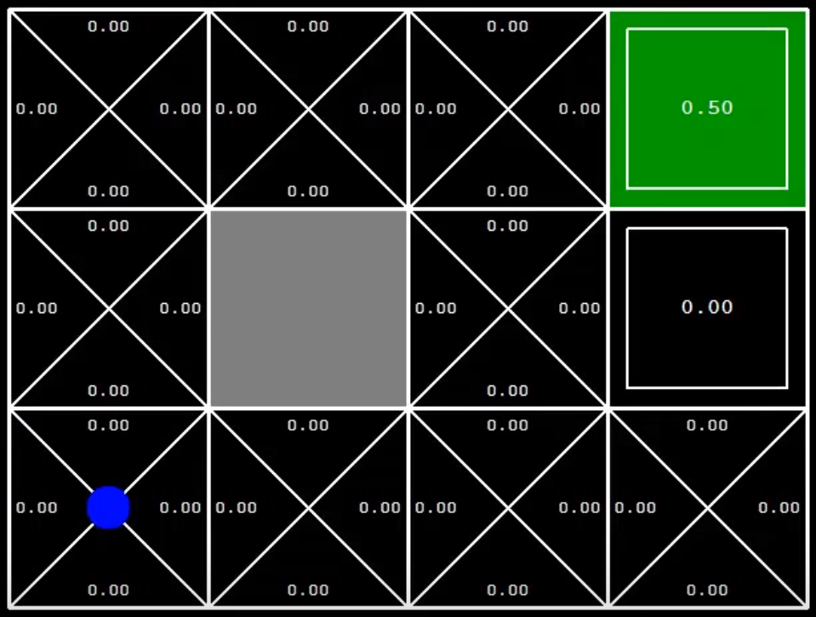
RL – Q-state Learning
Action 6

Slide 27

RL – Q-state Learning
Action 22

Slide 28



Exploration vs. Exploitation
$$f\left(u, n\right)=u+\frac{k}{n}$$
$$Q\left(s,a\right)=R\left(s,a,s^{′}\right)+γ∗\max_{a^{′}}{f(Q\left(s^{′},a^{′}\right), N(s^{′},a^{′}))}$$
Selected frequency

Slide 29
RL – Q-state Learning
Action 23

Slide 30

RL – Q-state Learning
Action 24

Slide 31

RL – Q-state Learning
Action 25

Slide 32

RL – Q-state Learning
Action 1000

Slide 33
Reference
CS188, Berkeley
https://www.youtube.com/channel/UCB4_W1V-KfwpTLxH9jG1_iA

